Slide 1
Team DarkKahn

Slide 2
Our Team
Elena Pitsin
Julis Meleshko
Borislava Hinova
Nikolay Karakehaiov
Filip Surbinovski
Marin Dimitrov

Slide 3
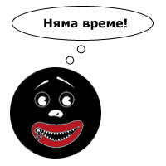
Flip Image Game
20 cards
Flip them and find the equal symbols
The clock is ticking
Purpose:
Train your memory
Get better and faster

Slide 4
Git Repository
https://github.com/epitsin/DarkKahn

